Slide 1
The Current Situation Regarding the Definition and Assessment of Dyslexia and/or Dyscalculia
The Malta Report
Ruth Falzon, Claudia Farrugia, Carmen Muscat
MDA Executive Council Members
June 2025
Vienna, EDA Summer Seminar

Slide 2
Overview
Definition – SpLD Unit
Much more support and personnel for Dyslexia than Dyscalculia
More personnel for assessment but much less for intervention
Inclusive
Education and policy
Master’s level Training
Link to the UK training

Slide 3
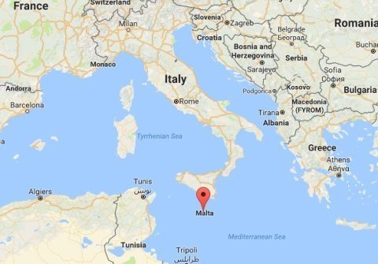
Presenting Malta
Southern European archipelago in Mediterranean Sea
80 km (50 mi) south of Italy,
284 km (176 mi) east of Tunisia, and
333 km (207 mi) north of Libya.
>560000 (Eurostat, 2023) people over
an area of 316 km² (122 sq mi)
World’s 10th Smallest and 5th
most densely populated country.

Slide 4
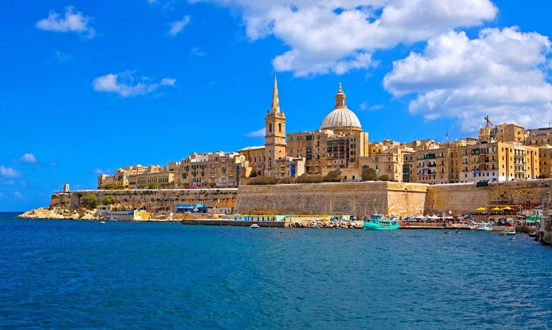
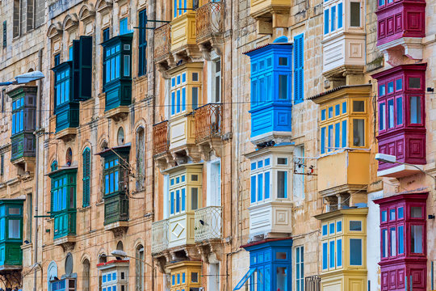
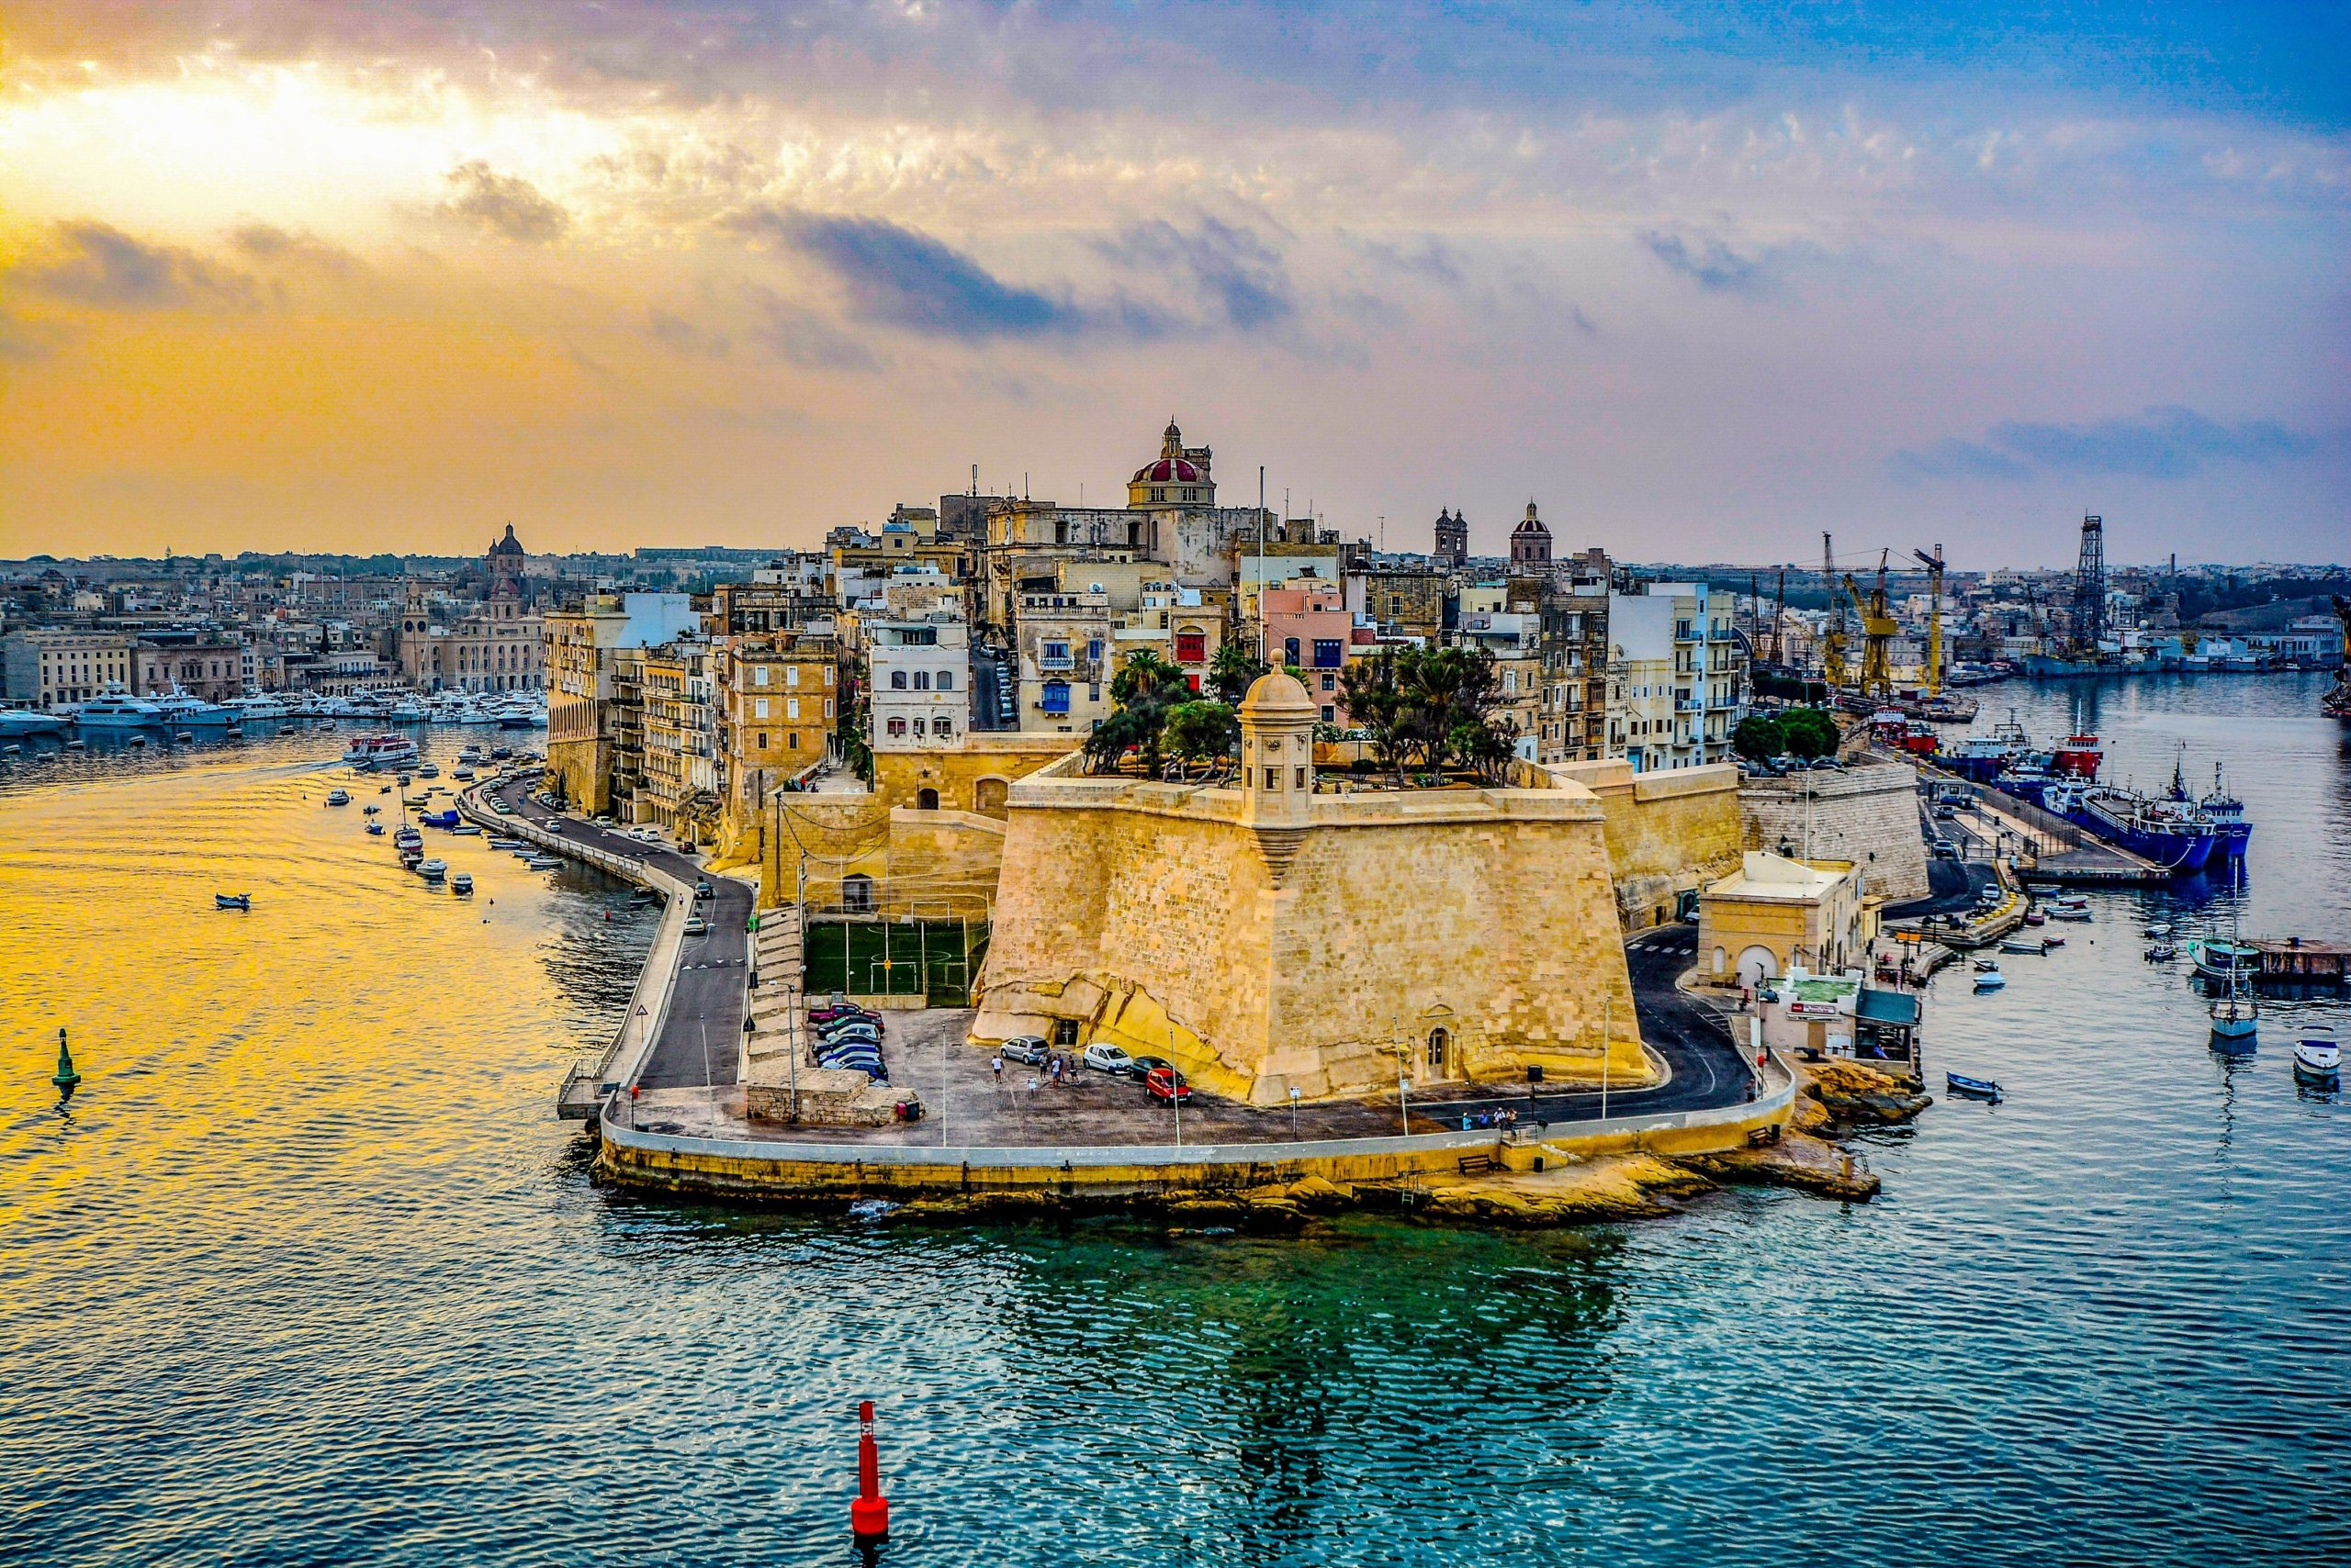
Capital City Valletta, smallest national capital in the European Union (0.8 km²).
Official languages are Maltese and English
Maltese only Semitic language in the European Union and the only Semitic language using Roman letters
Inhabited since approximately 5900 BC.

Slide 5
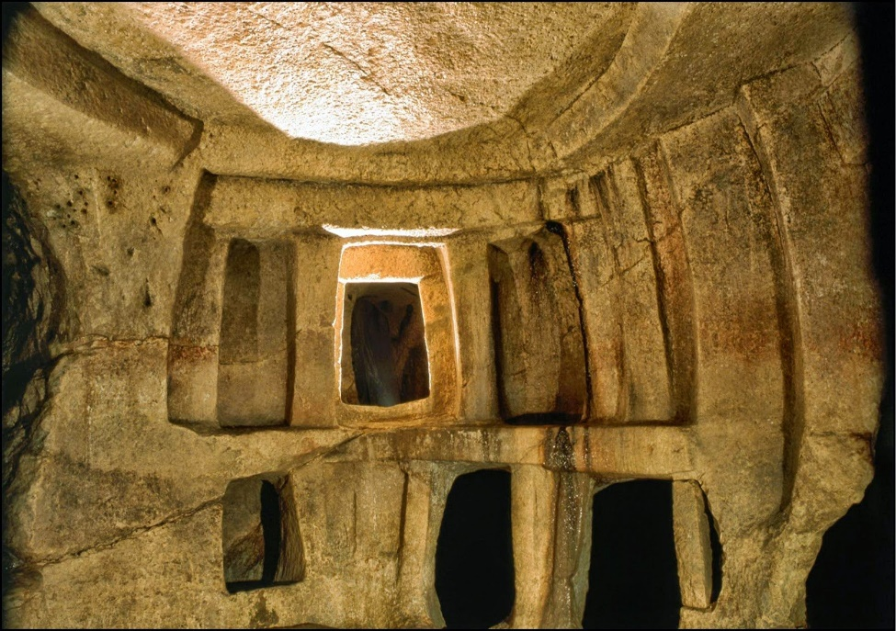
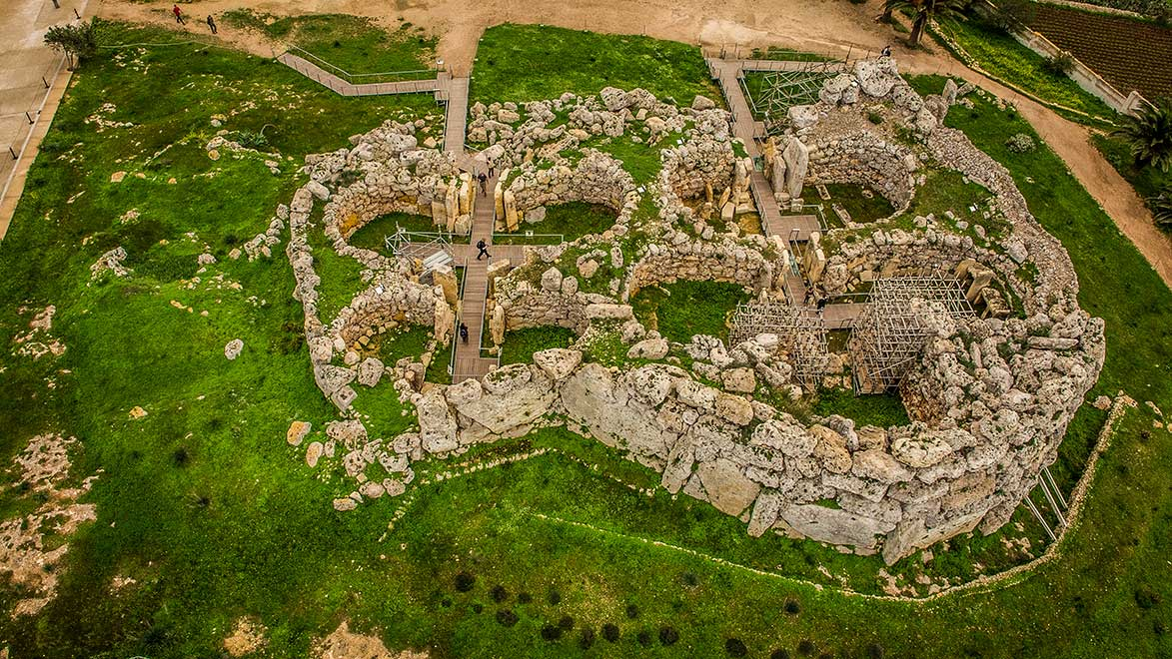
British colony in 1815-1964 influenced
Malta’s Legal and Education System
Independent,
Member state of the Commonwealth of Nations
1964 Member of the United Nations
1974 Republic of Malta
2004 European Union Member
2008 Eurozone monetary union in 2008.
Long Christian legacy. Archdiocese Apostolic See
as Paul the Apostle was shipwrecked on Malta,
according to Acts of the Apostles.
UNESCO World Heritage Sites: Hypogeum of Ħal-Saflieni, Valletta
Seven megalithic Temples some of the oldest free-standing structures world.

Slide 6
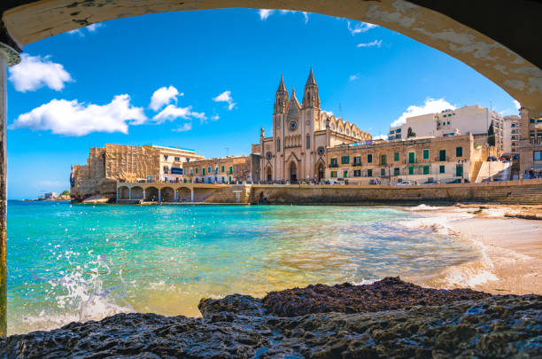
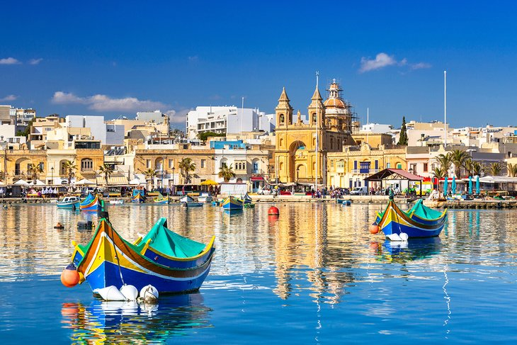
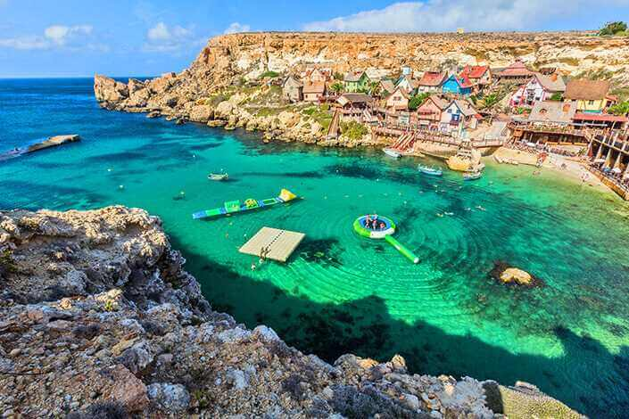
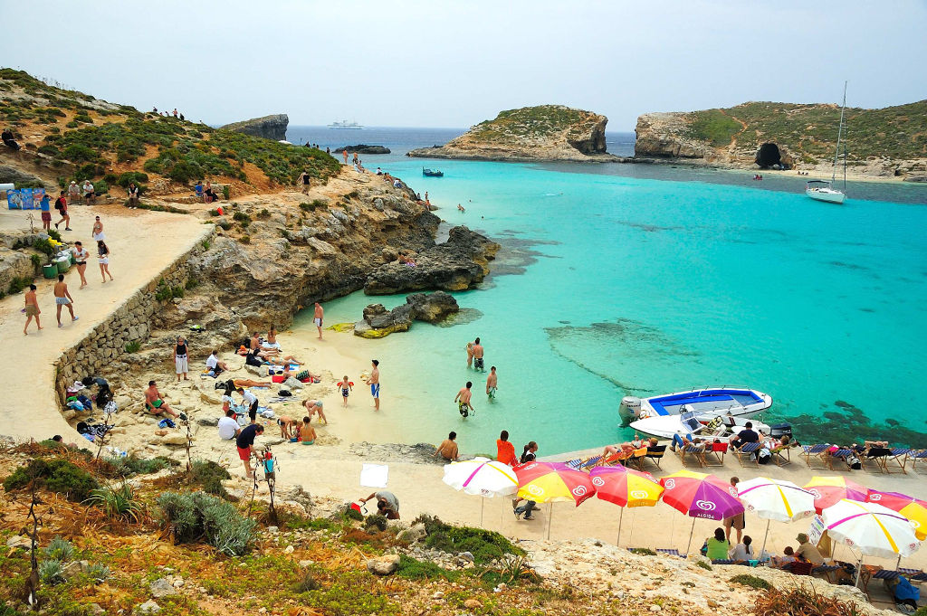
Maltese Schools
56% State Schools
31% Church Schools (state-funded)
13% Independent Schools

Slide 7
Language of Instruction
Lil din l-art ħelwa, l-Omm li tatna isimha, Ħares, Mulej, kif dejjem Int ħarist: Ftakar li lilha bil-oħla dawl libbist. Agħti, kbir Alla, id-dehen lil min jaħkimha, Rodd il-ħniena lis-sid, saħħa 'l-ħaddiem: Seddaq il-għaqda fil-Maltin u s-sliem
State Schools: Traditionally predominantly use Maltese.
Church Schools: Maltese and English.
Independent Schools: Primarily use English.
Due to cosmopolitan profile shift of the Malta Population State Schools are not also using Maltese and English. Teachers are also having to say the number in Maltese during math lessons.

Slide 8
School Characteristics
State Schools: Co-educational
Church Schools: Mostly single-sex institutions operated by the Catholic Church; they do not charge tuition fees but may request voluntary donations.
Independent: Co-educational and charge tuition fees. Since one school started as a Parents’ Foundation for Education in 1988, many are run by foundations.

Slide 9
Educational Structure
Free childcare 24 hours provided by the state and private enterprises
Early Years (0-3 years): Education provided by state, church, and independent childcare centers.
Early Years (3-5 years): Kindergartens operated by all three sectors.
Primary and Secondary Education: Available across state, church, and independent schools.
Post-Secondary Education: Limited private provision; primarily state-operated institutions - ITS, MCAST, UM, Post secondary schools for Matriculation.
This structure reflects Malta's commitment to providing diverse educational opportunities through collaboration between state and non-state actors.

Slide 10
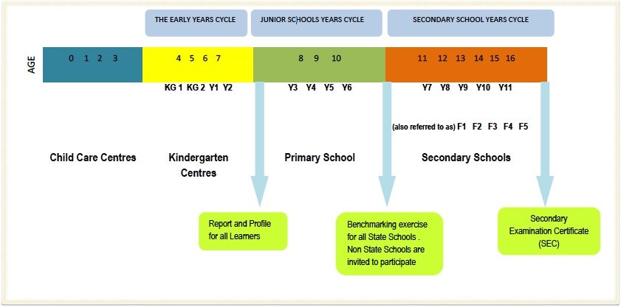
Structure of the Maltese Educational System
Language in Education Policy Profile (2014). Ministry for Education and Employment

Slide 11
The MATSEC Board
Examinations are regulated by the MATSEC Board. This is part of the University of Malta and is chaired by the Rector (or his/her representative).
The main function of the Board is to make recommendations to Senate required for the proper conduct of examinations.
The day to day running of the examinations is seen to by the MATSEC Support Unit.

Slide 12
The SEC examinations…
Students sit for these exams in various subjects at the end of compulsory schooling (age 16).
They are high stakes examinations as passes in a minimum of six subjects including core subjects are required for entry into most post-secondary institutions.

Slide 13
The Matriculation Certificate
This is based on the International Baccalaureate model.
Following two years of post-secondary education students sit for two Advanced Level examinations and three Intermediate examinations that cover subjects from both the humanities and science areas.
The Matriculation certificate is an obligatory entry requirement into the University of Malta.

Slide 14
Access Arrangements…
The policy of the MATSEC Board is to allow candidates with special needs the possibility to show their competence in the examination.
Applications from candidates requiring special arrangements are received at the time of registration and their requests are considered by the Special Needs Committee of the University.

Slide 15
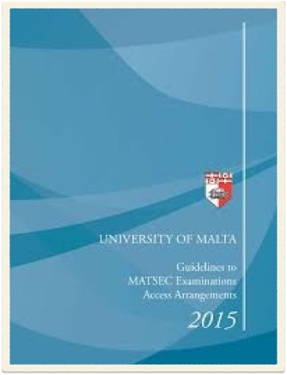
…Access Arrangements
The special arrangements granted depend on profile and its severity. All applications need to be accompanied by professional certification.
Some stakeholders question the fairness of making special arrangements since these may diminish integrity of examination.
Others feel that the Board is not generous enough with its provisions.
(Grima & Ventura, 2008).

Slide 16
Policy and Legal Framework
The Maltese legal framework supporting individuals with dyslexia and dyscalculia
Education Act and Special Education Needs (SEN) policies
Inclusion policies within public and private schools
The role of the National Literacy Agency and educational authorities
DSM-5-TR (APA, 2022); ICS-11 (WHO, 2024)

Slide 17
Assessment Possibilities
The state’s SpLD (Specific Learning Difficulties) Service in Malta
The Secretariat for Catholic Education
UM free assessment for ADHD only
MCAST – out sourcing and student-paid
Private Assessment

Slide 18
Assessment Processes in Practice
Who conducts assessments? – IQ PROFILE OBLIGATORY
Educational psychologists,
Speech and language therapists,
Literacy Specialist
SpLD Specialists
Occupational therapists (Dygraphia/Dypraxia/DCD)
Tools and criteria used:
Standardized tests, for Malta and the UK
Classroom observations,
Teacher reports

Slide 19
Strengths and Successes
Early identification
School Level Intervention programs
Availability of assistive technologies and tailored learning plans
Training and awareness initiatives for educators and parents
Integration of dyslexia-friendly teaching strategies in schools

Slide 20
Challenges and Barriers
Delays in assessment due to resource limitations
Variability in access to assessments across different schools
Limited awareness and training among some educators
Stigma and misconceptions surrounding learning difficulties
Challenges with intervention – lack of personnel, almost non-existent for dyscalculia

Slide 21
Educational vs. Clinical Settings
Public vs private practice: Differences in accessibility and resources
School-based vs independent assessments: Costs and waiting times
Integration of support services within mainstream schools

Slide 22
Emerging Trends and Innovations
Digital tools and AI-driven assessment methods
Research initiatives in dyslexia and dyscalculia interventions
Government initiatives to improve access and reduce delays
Collaboration with European institutions for best practices

Slide 23
NGOs
Malta Dyslexia Association
Autism Parents’ Association – Malta
ADHD Malta
MFOPD – Malta Federation of Organisations Persons with Disability
Malta Chamber of Psychologists
Malta Association for the Counselling Profession

Slide 24
Conclusion
Malta’s strengths
Areas for improvement
Future recommendations for policy training and practice
Encouraging further research and development in assessment methods

